Slide 1
Abstract Connoisseurs
Bryan Nonni, Steve Fassnacht, Alex Fleming

Slide 2
Problem Statement:
Create interactive map of Georgia highlighting areas of interest using only html/css
Requirements:
On load, the webpage is a image of Georgia with small icons for each area of interest over their relative true geographic locations
Inputs
1. User hovers the cursor over an icon
2. User moves cursor away from icon
Outputs
An Image and some information corresponding to the area of interest being hovered expands on top of background
The Image and information retract to just the icon as it were on load

Slide 3
Design
Background image is a minimalistic map of Georgia
Small icons show where the areas of interest are
Hovering on an icon will trigger the onHover attribute for the corresponding image
Page loads with image dimensions very small and area description set to invisible
onHover attribute will expand the image for the area of interest, and the corresponding description becomes visible
Moving curser away deactivates the onHover attribute, resetting the image and description to original minimized/invisible state

Slide 4
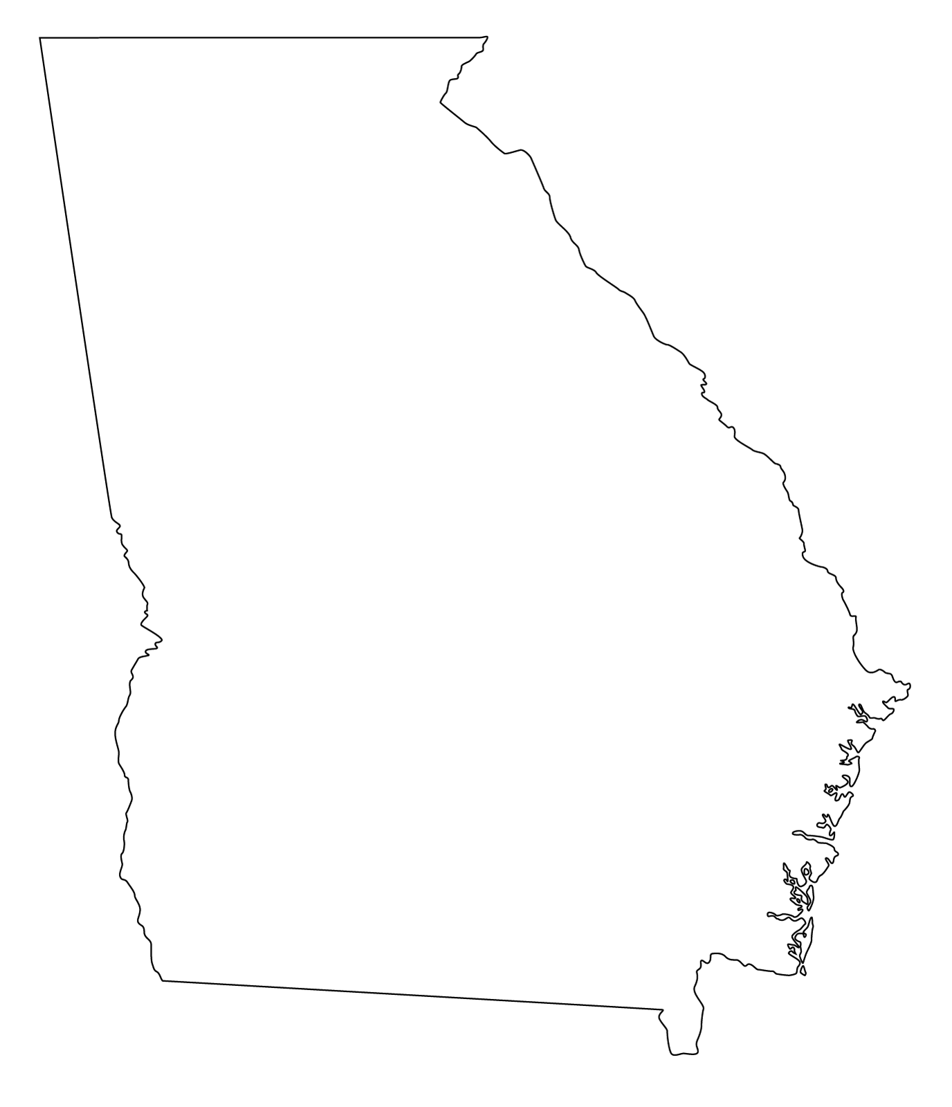
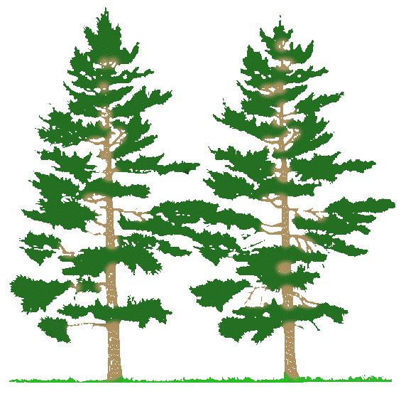
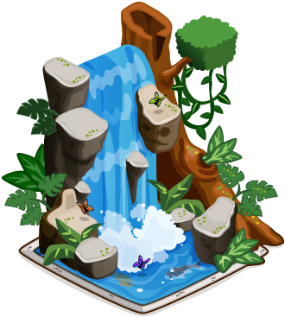





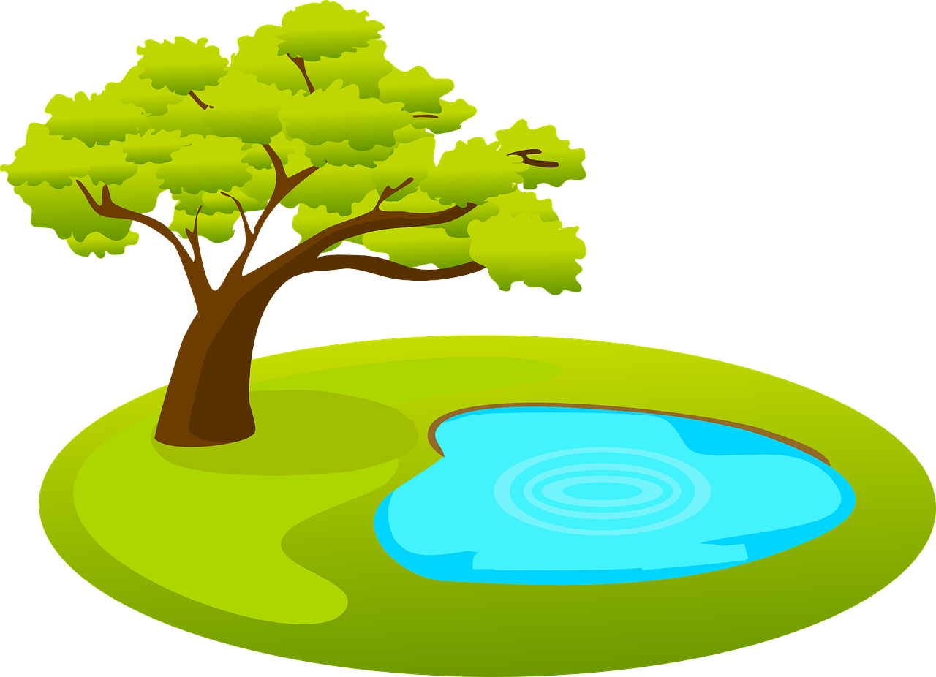
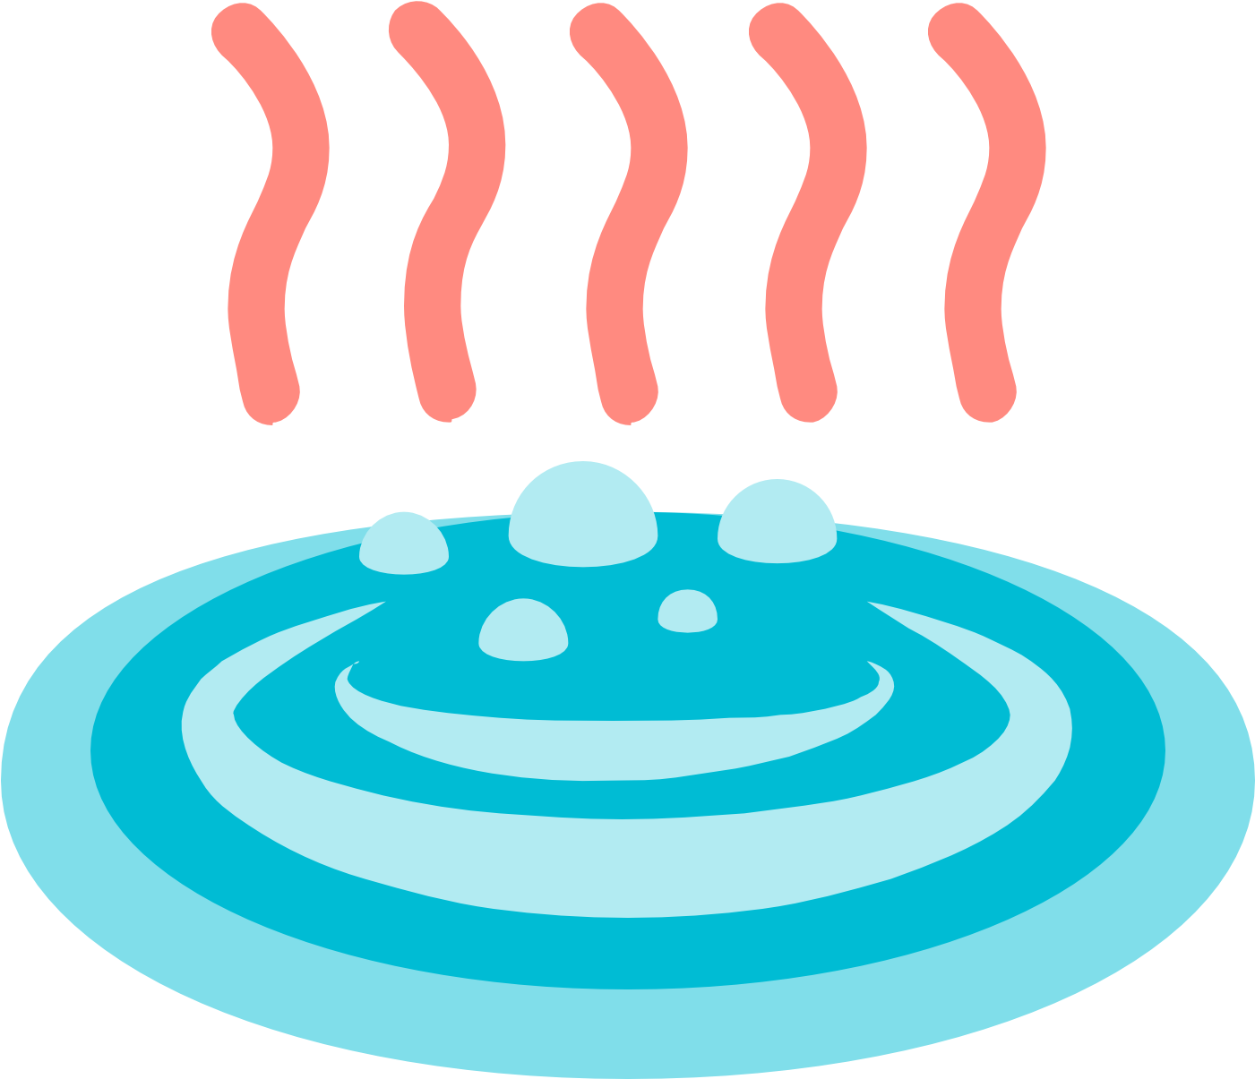

User Interface
Chattahoochee forest
Chattahoochee river
Red Top Mountain
Savannah
Providence Canyon
Macon
Radium Springs
Tallulah Gorge
Okefenokee Swamp
Warm Springs

Slide 5
Class Diagram

